Slide 1
Primary Care Equity Datapack
Data from latest period for Nottingham and Nottinghamshire

Slide 2
Introduction
Primary care (in contrast to specialty care) is associated with a more equitable distribution of health in populations.
A key role of commissioners is to ensure the equitable distribution of resources across the system.
We present the latest NHS primary care data, using Index of Multiple Deprivation (IMD) to examine inequalities in patient health determinants and outcomes, according the following categories:
Resources (supply): Payments, Workforce
Population (demand): Disease prevalence, Health-related behaviours
Service quality: QOF achievement
Access: Patient experience, Appointments
Impact on secondary care: Emergency admissions, A&E attendances
For further information or to discuss the results, please contact Dr John Ford

Slide 3
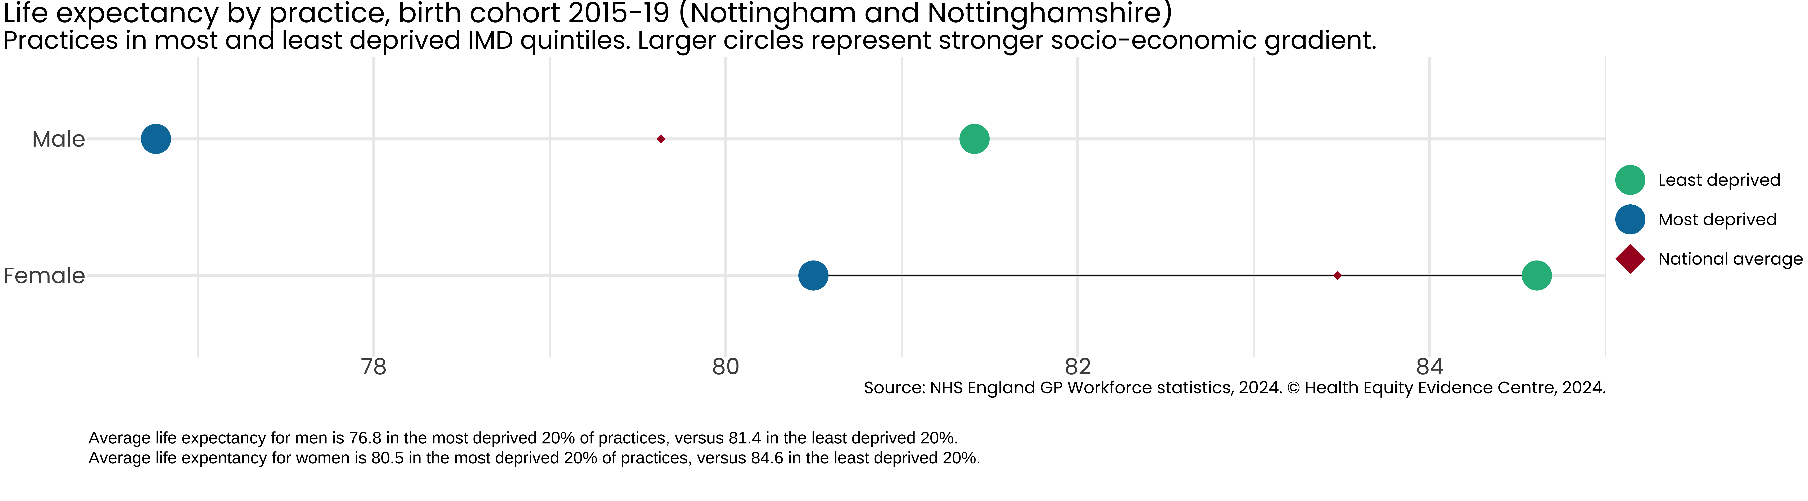
Inequality in Life Expectancy

Slide 4
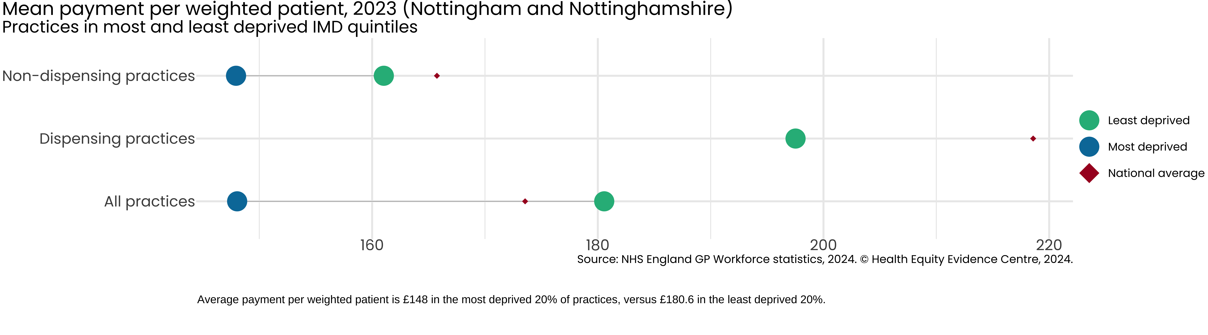
Inequality in NHS Payments

Slide 5
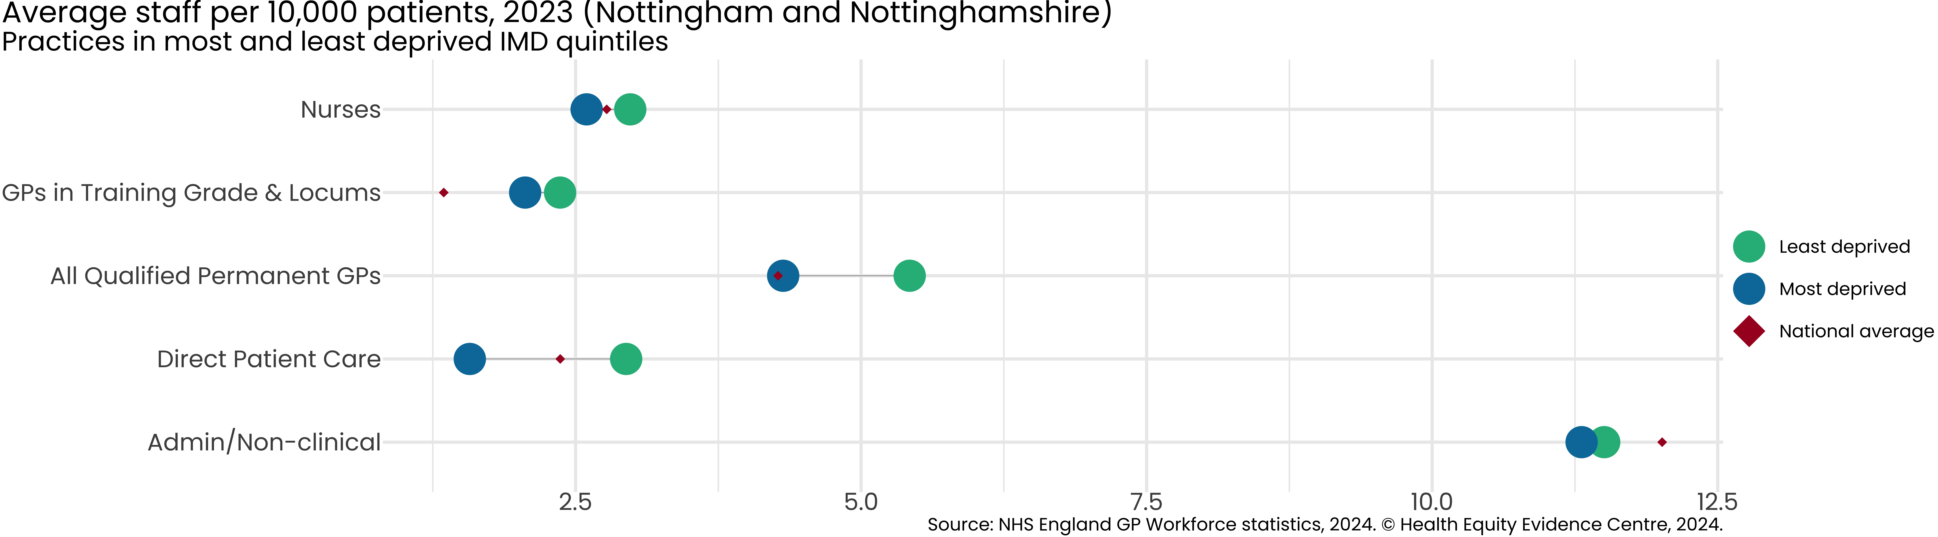
Inequality in Workforce

